Slide 1
Shortest Paths
0
8
A
4
2
8
7
2
1
3
B
C
D
5
3
9
8
2
E
F
5
Shortest Paths
Notes:
Shortest Path

Slide 2
Weighted Graphs
In a weighted graph, each edge has an associated numerical value, called the weight of the edge
Edge weights may represent, distances, costs, etc.
Example:
  In a flight route graph, the weight of an edge represents the distance in miles between the endpoint airports
849
PVD
1843
ORD
142
SFO
802
LGA
1743
1205
337
1387
HNL
2555
1099
LAX
1233
DFW
1120
MIA
Shortest Paths

Slide 3
Shortest Paths
Given a weighted graph and two vertices u and v, we want to find a path of minimum total weight between u and v.
  Length of a path is the sum of the weights of its edges.
Example:
  Shortest path between Providence and Honolulu
Applications
  Internet packet routing
  Flight reservations
  Driving directions
849
PVD
1843
ORD
142
SFO
802
LGA
1743
1205
337
1387
HNL
2555
1099
LAX
1233
DFW
1120
MIA
Shortest Paths

Slide 4
Shortest Path Properties
Property 1:
A subpath of a shortest path is itself a shortest path
Property 2:
There is a tree of shortest paths from a start vertex to all the other vertices
Example:
Tree of shortest paths from Providence
849
PVD
1843
ORD
142
SFO
802
LGA
1743
1205
337
1387
HNL
2555
1099
LAX
1233
DFW
1120
MIA
Shortest Paths

Slide 5
Dijkstra’s Algorithm
The distance of a vertex v from a vertex s is the length of a shortest path between s and v
Dijkstra’s algorithm computes the distances of all the vertices from a given start vertex s
Assumptions:
  the graph is connected
  the edge weights are nonnegative
We grow a “cloud” of vertices, beginning with s and eventually covering all the vertices
We store with each vertex v a label d(v) representing the distance of v from s in the subgraph consisting of the cloud and its adjacent vertices
At each step
  We add to the cloud the vertex u outside the cloud with the smallest distance label, d(u)
  We update the labels of the vertices adjacent to u
Shortest Paths

Slide 6
Edge Relaxation
Consider an edge e = (u,z) such that
  u is the vertex most recently added to the cloud
  z is not in the cloud
The relaxation of edge e updates distance d(z) as follows:
d(z) ← min{d(z),d(u) + weight(e)}
d(u) = 50
10
d(z) = 75
u
e
s
z
d(u) = 50
10
d(z) = 60
u
e
s
z
Shortest Paths

Slide 7
Example
0
0
8
A
4
8
A
4
2
2
8
7
2
1
4
8
7
2
1
3
B
C
D
B
C
D
∞
3
9
∞
5
3
9
8
2
E
F
5
2
E
F
5
0
0
8
A
4
8
A
4
2
2
8
7
2
1
3
7
7
2
1
3
B
C
D
B
C
D
5
3
9
11
5
3
9
8
2
E
F
5
2
E
F
5
Shortest Paths

Slide 8
Example (cont.)
0
8
A
4
2
7
7
2
1
3
B
C
D
5
3
9
8
2
E
F
5
0
8
A
4
2
7
7
2
1
3
B
C
D
5
3
9
8
2
E
F
5
Shortest Paths

Slide 9
Dijkstra's Shortest Path Algorithm
Find shortest path from s to t.
2
24
3
9
s
18
14
6
6
2
30
4
19
11
15
5
5
6
20
16
7
t
44

Slide 10
Dijkstra's Shortest Path Algorithm
S = { }
PQ = { s, 2, 3, 4, 5, 6, 7, t }
∞
∞
2
24
3
0
9
s
∞
18
14
6
6
2
∞
30
∞
4
19
11
15
5
5
6
20
16
7
t
44
distance label
∞
∞

Slide 11
Dijkstra's Shortest Path Algorithm
S = { }
PQ = { s, 2, 3, 4, 5, 6, 7, t }
delmin
∞
∞
2
24
3
0
9
s
∞
18
14
6
6
2
∞
30
∞
4
19
11
15
5
5
6
20
16
7
t
44
distance label
∞
∞

Slide 12
Dijkstra's Shortest Path Algorithm
S = { s }
PQ = { 2, 3, 4, 5, 6, 7, t }
decrease key
∞
∞
9
X
2
24
3
0
9
s
∞
14
18
14
X
6
6
2
∞
30
∞
4
19
11
15
5
5
6
20
16
7
t
44
distance label
∞
15
∞
X

Slide 13
Dijkstra's Shortest Path Algorithm
S = { s }
PQ = { 2, 3, 4, 5, 6, 7, t }
delmin
∞
∞
9
X
2
24
3
0
9
s
∞
14
18
14
X
6
6
2
∞
30
∞
4
19
11
15
5
5
6
20
16
7
t
44
distance label
∞
15
∞
X

Slide 14
Dijkstra's Shortest Path Algorithm
S = { s, 2 }
PQ = { 3, 4, 5, 6, 7, t }
∞
∞
9
X
2
24
3
0
9
s
∞
14
18
14
X
6
6
2
∞
30
∞
4
19
11
15
5
5
6
20
16
7
t
44
∞
15
∞
X

Slide 15
Dijkstra's Shortest Path Algorithm
S = { s, 2 }
PQ = { 3, 4, 5, 6, 7, t }
decrease key
∞
33
∞
X
9
X
2
24
3
0
9
s
∞
14
18
14
X
6
6
2
∞
30
∞
4
19
11
15
5
5
6
20
16
7
t
44
∞
15
∞
X

Slide 16
Dijkstra's Shortest Path Algorithm
S = { s, 2 }
PQ = { 3, 4, 5, 6, 7, t }
∞
33
∞
X
9
X
2
24
3
0
9
delmin
s
∞
14
18
14
X
6
6
2
∞
30
∞
4
19
11
15
5
5
6
20
16
7
t
44
∞
15
∞
X

Slide 17
Dijkstra's Shortest Path Algorithm
S = { s, 2, 6 }
PQ = { 3, 4, 5, 7, t }
32
∞
33
∞
X
X
9
X
2
24
3
0
9
s
∞
14
18
14
X
6
6
2
44
∞
∞
4
30
X
19
11
15
5
5
6
20
16
7
t
44
∞
15
∞
X

Slide 18
Dijkstra's Shortest Path Algorithm
S = { s, 2, 6 }
PQ = { 3, 4, 5, 7, t }
32
∞
33
∞
X
X
9
X
2
24
3
0
9
s
∞
14
18
14
X
6
6
2
44
∞
∞
4
30
X
19
11
15
5
5
6
20
16
7
t
44
∞
15
delmin
∞
X

Slide 19
Dijkstra's Shortest Path Algorithm
S = { s, 2, 6, 7 }
PQ = { 3, 4, 5, t }
32
∞
33
∞
X
X
9
X
2
24
3
0
9
s
∞
14
18
14
X
6
6
2
44
35
∞
X
∞
4
30
X
19
11
15
5
5
6
20
16
7
t
44
59
∞
∞
15
X
X

Slide 20
Dijkstra's Shortest Path Algorithm
S = { s, 2, 6, 7 }
PQ = { 3, 4, 5, t }
delmin
32
∞
33
∞
X
X
9
X
2
24
3
0
9
s
∞
14
18
14
X
6
6
2
44
35
∞
X
∞
4
30
X
19
11
15
5
5
6
20
16
7
t
44
59
∞
∞
15
X
X

Slide 21
Dijkstra's Shortest Path Algorithm
S = { s, 2, 3, 6, 7 }
PQ = { 4, 5, t }
32
∞
33
∞
X
X
9
X
2
24
3
0
9
s
∞
14
18
14
X
6
6
2
44
35
34
∞
X
X
∞
4
30
X
19
11
15
5
5
6
20
16
7
t
44
51
59
∞
∞
15
X
X
X

Slide 22
Dijkstra's Shortest Path Algorithm
S = { s, 2, 3, 6, 7 }
PQ = { 4, 5, t }
32
∞
33
∞
X
X
9
X
2
24
3
0
9
s
∞
14
18
14
X
6
6
2
44
35
34
∞
X
X
∞
4
30
X
19
11
15
5
5
6
20
delmin
16
7
t
44
51
59
∞
∞
15
X
X
X

Slide 23
Dijkstra's Shortest Path Algorithm
S = { s, 2, 3, 5, 6, 7 }
PQ = { 4, t }
32
∞
33
∞
X
X
9
X
2
24
3
0
9
s
∞
14
18
14
X
6
6
2
35
34
45
∞
44
X
X
X
∞
4
30
X
19
11
15
5
5
6
20
16
7
t
44
50
51
59
∞
∞
15
X
X
X
X

Slide 24
Dijkstra's Shortest Path Algorithm
S = { s, 2, 3, 5, 6, 7 }
PQ = { 4, t }
32
∞
33
∞
X
X
9
X
2
24
3
0
9
s
∞
14
18
14
X
6
6
2
35
34
45
∞
44
X
X
X
∞
4
30
X
19
11
15
5
delmin
5
6
20
16
7
t
44
50
51
59
∞
∞
15
X
X
X
X

Slide 25
Dijkstra's Shortest Path Algorithm
S = { s, 2, 3, 4, 5, 6, 7 }
PQ = { t }
32
∞
33
∞
X
X
9
X
2
24
3
0
9
s
∞
14
18
14
X
6
6
2
35
34
45
∞
44
X
X
X
∞
4
30
X
19
11
15
5
5
6
20
16
7
t
44
50
51
59
∞
∞
15
X
X
X
X

Slide 26
Dijkstra's Shortest Path Algorithm
S = { s, 2, 3, 4, 5, 6, 7 }
PQ = { t }
32
∞
33
∞
X
X
9
X
2
24
3
0
9
s
∞
14
18
14
X
6
6
2
35
34
45
∞
44
X
X
X
∞
4
30
X
19
11
15
5
5
6
20
16
7
t
44
delmin
50
51
59
∞
∞
15
X
X
X
X

Slide 27
Dijkstra's Shortest Path Algorithm
S = { s, 2, 3, 4, 5, 6, 7, t }
PQ = { }
32
∞
33
∞
X
X
9
X
2
24
3
0
9
s
∞
14
18
14
X
6
6
2
35
34
45
∞
44
X
X
X
∞
4
30
X
19
11
15
5
5
6
20
16
7
t
44
50
51
59
∞
∞
15
X
X
X
X

Slide 28
Dijkstra's Shortest Path Algorithm
S = { s, 2, 3, 4, 5, 6, 7, t }
PQ = { }
32
∞
33
∞
X
X
9
X
2
24
3
0
9
s
∞
14
18
14
X
6
6
2
35
34
45
∞
44
X
X
X
∞
4
30
X
19
11
15
5
5
6
20
16
7
t
44
50
51
59
∞
∞
15
X
X
X
X

Slide 29
Dijkstra’s Algorithm
A heap-based adaptable priority queue with location-aware entries stores the vertices outside the cloud
  Key: distance
  Value: vertex
  Recall that method replaceKey(l,k) changes the key of entry l
We store two labels with each vertex:
  Distance
  Entry in priority queue
Algorithm DijkstraDistances(G, s)
Q ← new heap-based priority queue
for all v ∈ G.vertices()
if v = s
v.setDistance(0)
else
v.setDistance(∞)
l ← Q.insert(v.getDistance(), v)
  v.setEntry(l)
  while ¬Q.empty()
  l ← Q.removeMin()
  u ← l.getValue()
  for all e ∈ u.incidentEdges() { relax e }
  z ← e.opposite(u)
  r ← u.getDistance() + e.weight()
  if r < z.getDistance()
  z.setDistance(r)
  Q.replaceKey(z.getEntry(), r)
Shortest Paths

Slide 30
Analysis of Dijkstra’s Algorithm
Graph operations
  Method incidentEdges is called once for each vertex
Label operations
  We set/get the distance and locator labels of vertex z O(deg(z)) times
  Setting/getting a label takes O(1) time
Priority queue operations
  Each vertex is inserted once into and removed once from the priority queue, where each insertion or removal takes O(log n) time
  The key of a vertex in the priority queue is modified at most deg(w) times, where each key change takes O(log n) time
Dijkstra’s algorithm runs in O((n + m) log n) time provided the graph is represented by the adjacency list structure
  Recall that Σ_{v} deg(v) = 2m
The running time can also be expressed as O(m log n) since the graph is connected
Shortest Paths

Slide 31
Shortest Paths Tree
Using the template method pattern, we can extend Dijkstra’s algorithm to return a tree of shortest paths from the start vertex to all other vertices
We store with each vertex a third label:
  parent edge in the shortest path tree
In the edge relaxation step, we update the parent label
Algorithm DijkstraShortestPathsTree(G, s)
  …
for all v ∈ G.vertices()
  …
v.setParent(∅)
  …
  for all e ∈ u.incidentEdges()
  { relax edge e }
  z ← e.opposite(u)
  r ← u.getDistance() + e.weight()
  if r < z.getDistance()
  z.setDistance(r)
  z.setParent(e)
  Q.replaceKey(z.getEntry(),r)
Shortest Paths

Slide 32
Why Dijkstra’s Algorithm Works
Dijkstra’s algorithm is based on the greedy method. It adds vertices by increasing distance.
  Suppose it didn’t find all shortest distances. Let F be the first wrong vertex the algorithm processed.
  When the previous node, D, on the true shortest path was considered, its distance was correct
  But the edge (D,F) was relaxed at that time!
  Thus, so long as d(F)>d(D), F’s distance cannot be wrong. That is, there is no wrong vertex
0
8
A
4
2
7
7
2
1
3
B
C
D
5
3
9
8
2
E
F
5
Shortest Paths

Slide 33
Dijkstra’s Algorithm - Example
1
10
2
3
9
4
6
5
7
D
2

Slide 34
Dijkstra’s Algorithm - Example
1
∞
∞
10
2
3
9
0
4
6
5
7
∞
∞
2

Slide 35
Dijkstra’s Algorithm - Example
1
10
∞
10
2
3
9
0
4
6
5
7
5
∞
2

Slide 36
Dijkstra’s Algorithm - Example
1
10
∞
10
2
3
9
0
4
6
5
7
5
∞
2

Slide 37
Dijkstra’s Algorithm - Example
1
8
14
10
2
3
9
0
4
6
5
7
5
7
2

Slide 38
Dijkstra’s Algorithm - Example
1
8
14
10
2
3
9
0
4
6
5
7
5
7
2

Slide 39
Dijkstra’s Algorithm - Example
1
8
13
10
2
3
9
0
4
6
5
7
5
7
2

Slide 40
Dijkstra’s Algorithm - Example
1
8
13
10
2
3
9
0
4
6
5
7
5
7
2

Slide 41
Dijkstra’s Algorithm - Example
1
8
9
10
2
3
9
0
4
6
5
7
5
7
2

Slide 42
Dijkstra’s Algorithm - Example
1
8
9
10
2
3
9
0
4
6
5
7
5
7
2

Slide 43

Why It Doesn’t Work for Negative-Weight Edges
Dijkstra’s algorithm is based on the greedy method. It adds vertices by increasing distance.
0
8
A
4
  If a node with a negative incident edge were to be added late to the cloud, it could mess up distances for vertices already in the cloud.
6
7
7
5
1
4
B
C
D
5
0
-8
9
2
E
F
5
C’s true distance is 1, but it is already in the cloud with d(C)=5!
Shortest Paths

Slide 44
Bellman-Ford Algorithm
Works even with negative-weight edges
Must assume directed edges (for otherwise we would have negative-weight cycles)
Iteration i finds all shortest paths that use i edges.
Running time: O(nm).
Can be extended to detect a negative-weight cycle if it exists
  How?
Algorithm BellmanFord(G, s)
for all v ∈ G.vertices()
if v = s
v.setDistance(0)
else
v.setDistance(∞)
for i ← 1 to n − 1 do
  for each e ∈ G.edges()
  { relax edge e }
  u ← e.origin()
  z ← e.opposite(u)
  r ← u.getDistance() + e.weight()
  if r < z.getDistance()
  z.setDistance(r)
Shortest Paths

Slide 45
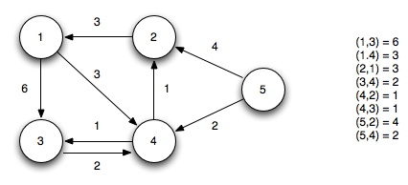
Bellman-Ford Algorithm
start
Shortest Paths

Slide 46
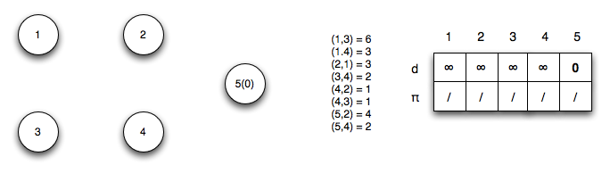
Bellman-Ford Algorithm
Using vertex 5 as the source (setting its distance to 0), we initialize all the other distances to ∞.
Shortest Paths

Slide 47
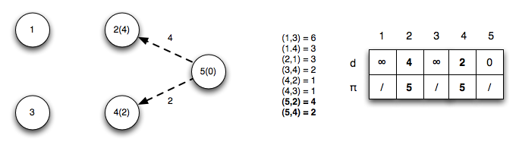
Bellman-Ford Algorithm
Iteration 1: Edges (u₅,u₂) and (u₅,u₄) relax updating the distances to 2 and 4
Shortest Paths

Slide 48
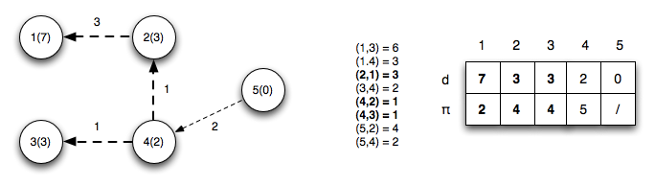
Bellman-Ford Algorithm
Iteration 2: Edges (u₂,u₁), (u₄,u₂) and (u₄,u₃) relax updating the distances to 1, 2, and 4 respectively. Note edge (u₄,u₂) finds a shorter path to vertex 2 by going through vertex 4
Shortest Paths

Slide 49
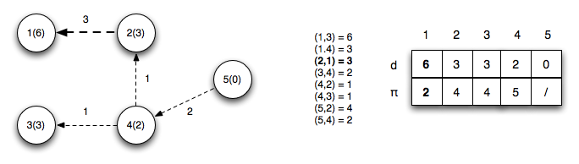
Bellman-Ford Algorithm
Iteration 3: Edge (u2,u1) relaxes (since a shorter path to vertex 2 was found in the previous iteration) updating the distance to 1
Shortest Paths

Slide 50
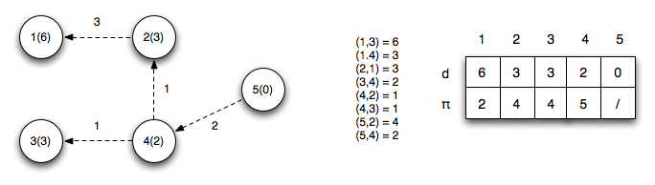
Bellman-Ford Algorithm
Iteration 4: No edges relax
Shortest Paths

Slide 51
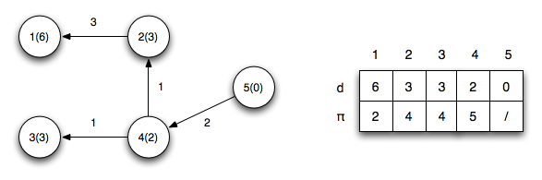
Bellman-Ford Algorithm
The final shortest paths from vertex 5 with corresponding distances is
Shortest Paths

Slide 52
Bellman-Ford Algorithm
Negative cycle checks: We now check the relaxation condition one additional time for each edge. If any of the checks pass then there exists a negative weight cycle in the graph.
v3.d > u1.d + w(1,3) ⇒ 3 ≯ 6 + 6 = 12 ✓
v4.d > u1.d + w(1,4) ⇒ 2 ≯ 6 + 3 = 9 ✓
v1.d > u2.d + w(2,1) ⇒ 6 ≯ 3 + 3 = 6 ✓
v4.d > u3.d + w(3,4) ⇒ 2 ≯ 3 + 2 = 5 ✓
v2.d > u4.d + w(4,2) ⇒ 3 ≯ 2 + 1 = 3 ✓
v3.d > u4.d + w(4,3) ⇒ 3 ≯ 2 + 1 = 3 ✓
Shortest Paths

Slide 53

Bellman-Ford Algorithm Example
1
7
1
3
s
8
5
3
2
4
0
2
2
5
4

Slide 54
Bellman-Ford Algorithm Example
1
7
1
7
s
7
8
5
s
3
2
8
4
4
2
5
3
0
2
0
2
5
5
2

Slide 55
Bellman-Ford Algorithm Example
1
7
1
5
1
8
7
s
7
8
5
s
7
3
s
8
2
8
3
4
4
5
2
4
2
5
3
0
2
0
0
2
2
5
5
2
2
5
7

Slide 56
Bellman-Ford Algorithm Example
1
7
1
5
1
8
7
s
7
8
5
s
7
3
s
8
2
8
3
4
4
5
2
4
2
5
3
0
2
0
0
2
2
5
5
2
2
5
7
5
6
1
7
s
8
2
3
4
5
0
2
5
2
7

Slide 57
Bellman-Ford Algorithm Example
1
7
1
5
1
8
7
s
7
8
5
s
7
3
s
8
2
8
3
4
4
5
2
4
2
5
3
0
2
0
0
2
2
5
5
2
2
5
7
5
6
5
6
1
1
7
7
s
s
8
8
2
2
3
3
4
4
5
5
0
0
2
2
5
5
2
7
2
7

Slide 58
Bellman-Ford Example
t
5
x
∞
-2
∞
6
-3
s
0
8
-4
7
2
7
∞
∞
9
y
z

Slide 59
Bellman-Ford Example
t
5
x
t
5
x
∞
-2
∞
6
-2
∞
6
6
-3
-3
s
0
8
s
0
8
-4
7
-4
7
2
2
7
7
∞
∞
7
∞
9
9
y
z
y
z

Slide 60
Bellman-Ford Example
t
5
x
t
5
x
∞
-2
∞
6
-2
∞
6
6
-3
-3
s
0
8
s
0
8
-4
7
-4
7
2
2
7
7
∞
∞
7
∞
9
9
y
z
y
z
t
5
x
6
-2
4
6
-3
s
0
8
-4
7
2
7
7
2
9
y
z

Slide 61
Bellman-Ford Example
t
5
x
t
5
x
∞
-2
∞
6
-2
∞
6
6
-3
-3
s
0
8
s
0
8
-4
7
-4
7
2
2
7
7
∞
∞
7
∞
9
9
y
z
y
z
t
5
x
t
5
x
6
-2
4
2
-2
4
6
6
-3
-3
s
0
8
s
0
8
-4
7
-4
7
2
2
7
7
7
2
7
2
9
9
y
z
y
z

Slide 62
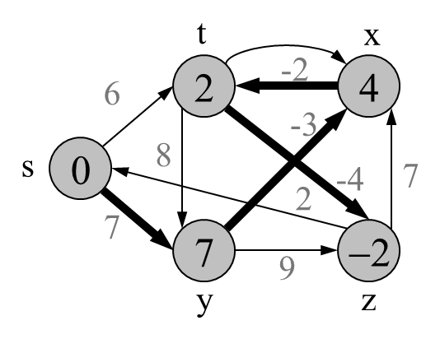
Bellman-Ford Example
t
5
x
t
5
x
6
-2
4
6
-2
∞
6
6
-3
-3
s
0
8
s
0
8
-4
7
-4
7
2
2
7
7
7
2
7
∞
9
9
y
z
y
z
t
5
x
2
-2
4
6
-3
s
0
8
-4
7
2
7
7
2
9
y
z

Slide 63
Bellman-Ford Example
t
5
x
2
-2
4
6
-3
s
0
8
-4
7
2
9
7
−2
9
y
z
Bellman-Ford running time:
  (|V|-1)|E| + |E| = Θ(VE)

Slide 64
DAG-based Algorithm
(not in book)
Algorithm DagDistances(G, s)
for all v ∈ G.vertices()
if v = s
v.setDistance(0)
else
v.setDistance(∞)
{ Perform a topological sort of the vertices }
for u ← 1 to n do {in topological order}
  for each e ∈ u.outEdges()
  { relax edge e }
  z ← e.opposite(u)
  r ← u.getDistance() + e.weight()
  if r < z.getDistance()
  z.setDistance(r)
Works even with negative-weight edges
Uses topological order
Doesn’t use any fancy data structures
Is much faster than Dijkstra’s algorithm
Running time: O(n+m).
Shortest Paths

Slide 65
DAG Example
Nodes are labeled with their d(v) values
1
1
8
0
4
8
0
4
-2
-2
3
7
2
1
4
3
8
7
2
-2
1
4
4
∞
∞
∞
∞
∞
∞
3
9
3
9
-5
∞
∞
5
-5
∞
∞
5
6
5
6
5
1
1
8
0
4
8
0
4
-2
-2
3
5
7
2
1
4
-1
3
7
2
1
4
8
-2
4
5
-2
-1
3
9
3
9
-5
1
7
5
-5
0
4
5
∞
∞
1
7
6
5
6
5
Shortest Paths
(two steps)

